Slide 1

ML FOR WIRELESS COMMUNICATION
UNSUPERVISED MACHINE LEARNING-BASED USER CLUSTERING IN THZ-NOMA SYSTEMS
TEAM:
ABHINAV DESHPANDE (IMT2022580)
AJITESH KUMAR SINGH (IMT2022559)

Slide 2


TABLE OF CONTENTS
Problem Statement
System Modelling and Beamforming
Problem definition
K-means
DBSCAN
AHC
DBSCAN and AHC results
Future Work

Slide 3

PROBLEM STATEMENT
6G Communication Need:
5G networks cannot meet future demands (ultra-high throughput, massive connectivity, ultra-low latency).
THz-NOMA as a Solution:
Terahertz (THz) spectrum offers ultra high bandwidth for communication.
Non-Orthogonal Multiple Access (NOMA) enhances spectral efficiency by allowing multiple users to share bandwidth.
Key Challenge:
Efficient user clustering in THz-NOMA networks without predefined cluster numbers.
Keep it or delete it!
Same

Slide 4
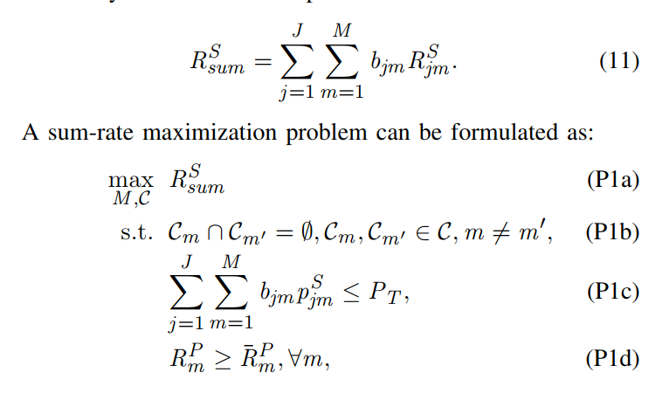
PROBLEM DEFINITION
Optimisation Problem:
Goal: Maximize the sum of data rates for all secondary users.
Constraints:
1. Each user should be assigned to a single cluster. (P1-b)
2. Total power of all secondary users ≤ total BS power. (P1-c)
3. Primary user data rate ≥ minimum QoS requirement. (P1-d)
Keep it or delete it!
Same

Slide 5
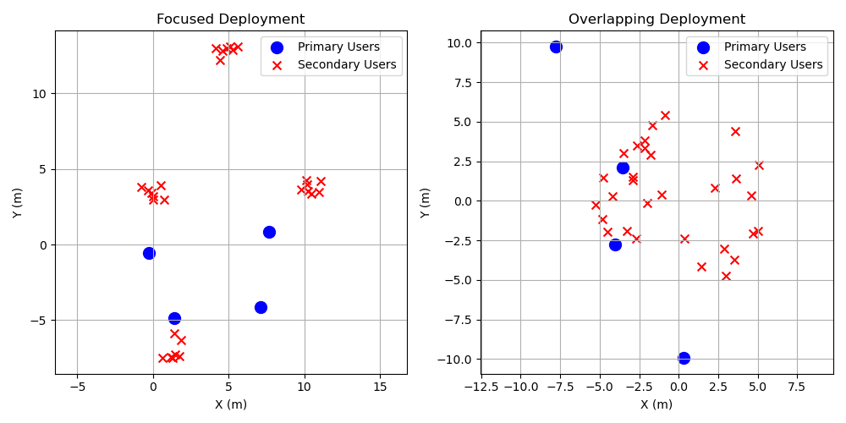
SECONDARY USERS DEPLOYMENT
Keep it or delete it!
Same

Slide 6

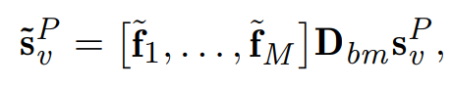

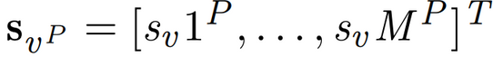
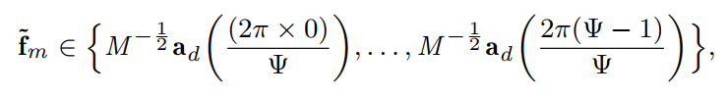
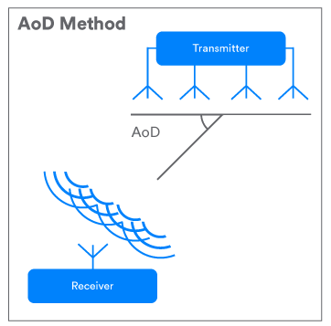
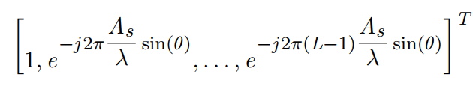
BEAMFORMING
Hybrid beamforming (analog and digital combined) for primary users.
Digital beamforming matrix
Signal vector sent from B.S.
to primary user
Analog Beamforming vector
Keep it or delete it!
Same
AOD (angle of departure)

Slide 7
PROPOSED USER CLUSTERING APPROACHES
Keep it or delete it!

Slide 8
K-MEANS
Group users based on AOD: Each secondary user (j) has an AOD value (aj) which is assigned to nearest centroid based on distance
Centroids are updated till the condition for stopping is achieved. (standard k-means approach)
Limitations:
Uses a pre-defined number of clusters (k).
Forces outliers into clusters.
Sensitive to initial centroid selection
We are going to use k-means as a benchmark for other proposed algorithms.
Keep it or delete it!
Angle of Departure

Slide 9
DBSCAN USER CLUSTERING
Density-based spatial clustering application with noise
Algorithm:
For all users (1 -> N):
Start with an unvisited user. Check if it has atleast minPts neighbours in Epsilon neighbourhood.
If yes (we call this dense enough), form a new cluster and expand it by adding reachable users.
If no, label it as noise. (although this can be changed later)
Keep it or delete it!
Same
Advantages over k-means:
Determines K dynamically
Labels outliers as noise
Limitations:
Hyperparameters: minPts, Epsilon need to be pre-configured.

Slide 10
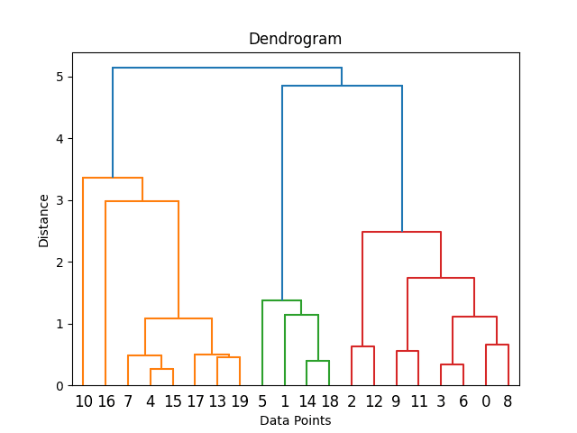
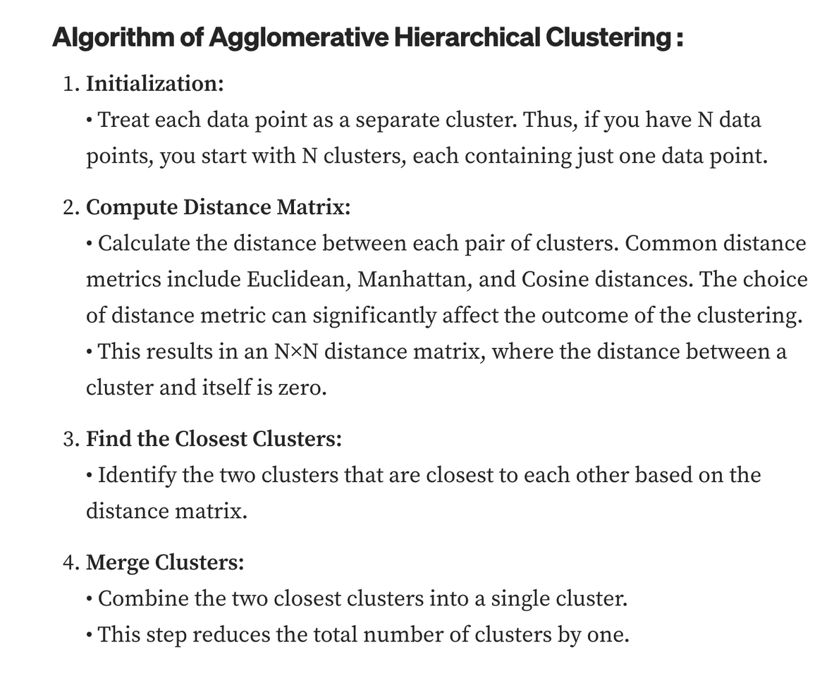
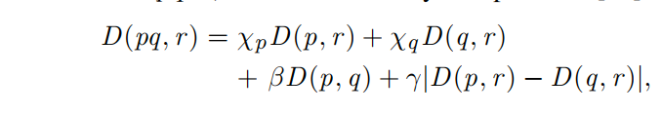
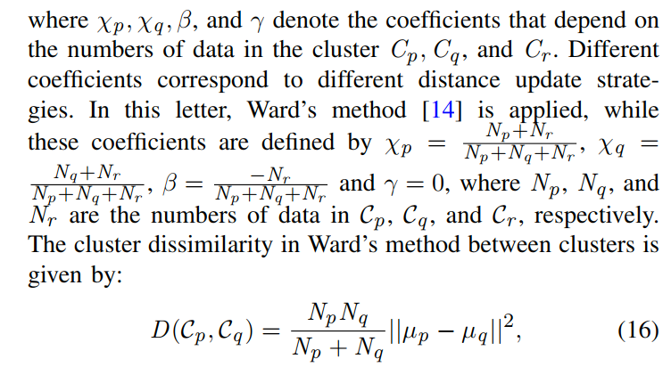
AHC
Same

Slide 11
RESULTS OBTAINED
Keep it or delete it!
Link to codebase

Slide 12
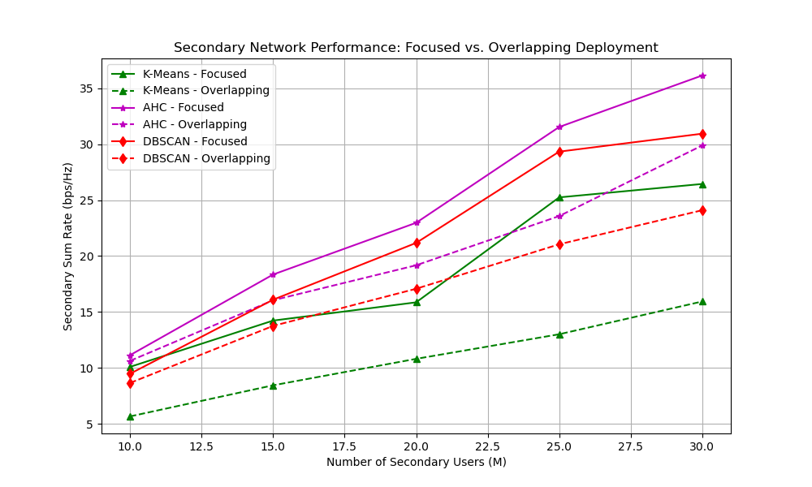
SUM DATA RATE AGAINST THE NUMBER OF SECONDARY USERS
Keep it or delete it!
Same

Slide 13
INFERENCE
Focused deployments lead to higher secondary sum rates across all algorithms compared to overlapping deployments
AHC outperforms the other two algorithms, while K-Means and DBSCAN are no longer promising when the number of clusters and hyper-parameters are randomly chosen.
Overall, AHC + focused deployment is the most effective strategy for maximizing secondary network throughput.
Same

Slide 14
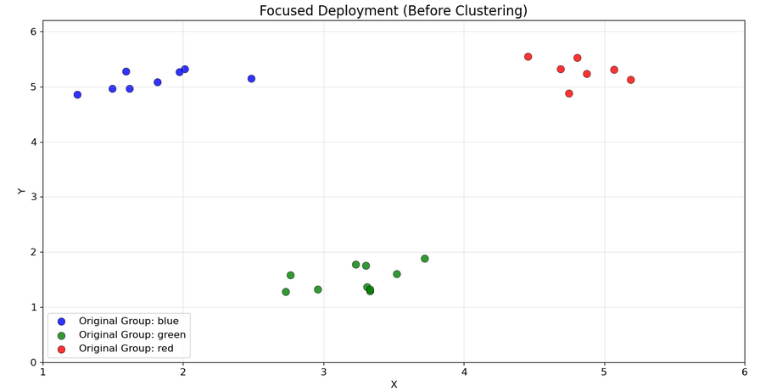
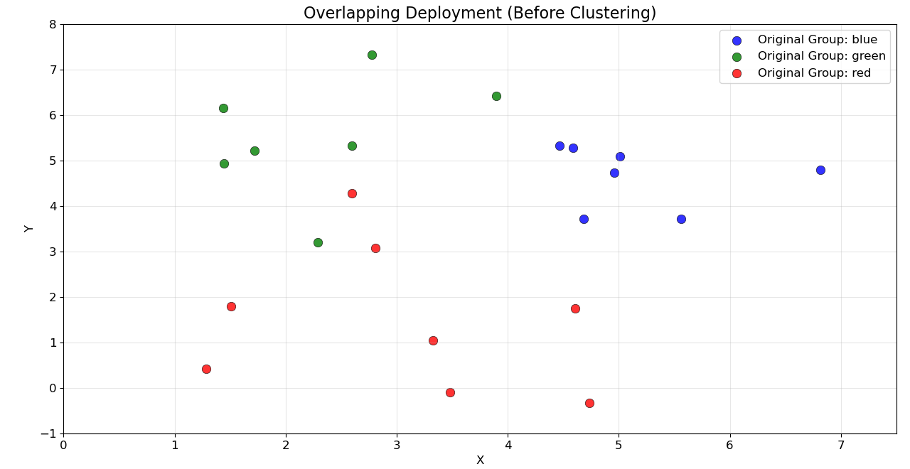
INITIAL USER DEPLOYMENT
Initial Data: We begin with two distinct datasets ("Focused" and "Overlapping"), each containing points pre-labeled into three 'Original Groups' (blue, green, red).
Visual Separation: The 'Focused' dataset initially shows clear spatial separation between these original groups, whereas the 'Overlapping' dataset shows the points from different original groups are spatially mixed.

Slide 15
DBSCAN
Keep it or delete it!

Slide 16
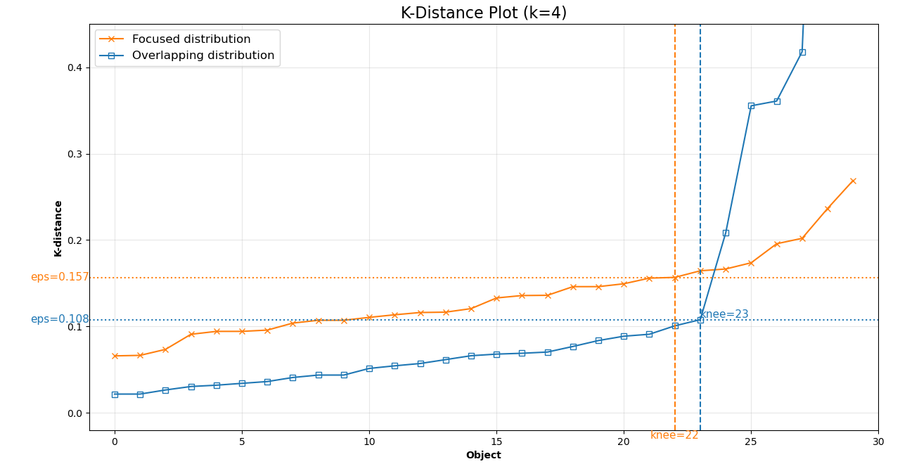
KNN - DBSCAN
Optimal eps Identified: K-Distance plot suggests optimal DBSCAN eps values at the "knee": ≈ 0.157 for Focused and ≈ 0.108 for Overlapping distributions (using k=4).
Density Structure Differences: The distinct eps values reflect differing local point densities; the Overlapping distribution appears denser (requiring smaller eps) based on 4th neighbor distances.
Parameter Guidance: This plot provides crucial data-driven guidance for setting the eps parameter in DBSCAN, aiming to capture core points effectively for each dataset's unique structure.

Slide 17
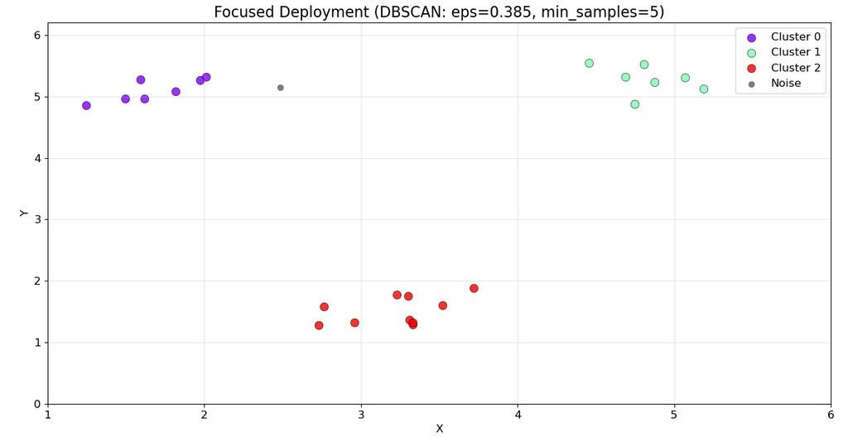
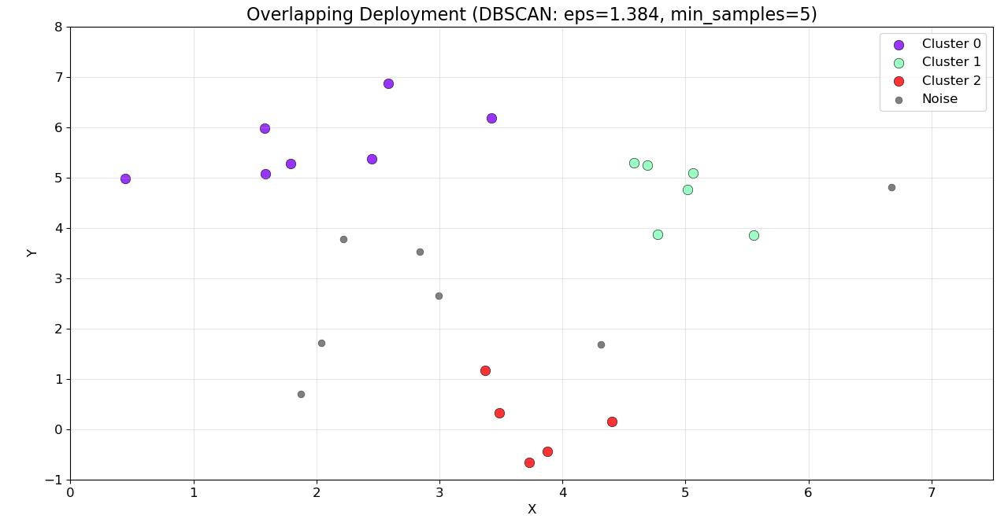
DBSCAN-CLUSTERING
Cluster Identification & Noise: DBSCAN successfully identified 3 primary clusters in both datasets using the specified parameters. It also effectively isolated points not belonging to dense regions as 'Noise'.
Dataset Sensitivity: The Overlapping dataset resulted in significantly more 'Noise' points, highlighting DBSCAN's sensitivity to density variations and its ability to handle less clearly separated or sparser data structures compared to the Focused dataset.

Slide 18
AHC
Keep it or delete it!

Slide 19
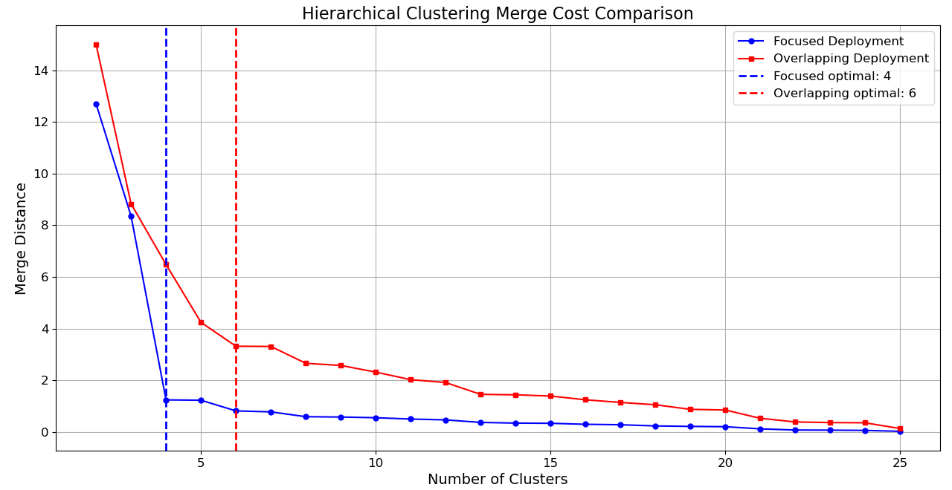
AHC MERGE COST
Optimal Cluster Counts Identified: via the elbow method: 4 clusters for Focused Deployment and 6 clusters for Overlapping Deployment.
Deployment Strategy Impacts Structure: The different optimal cluster counts (4 vs. 6) suggest that the underlying natural groupings vary significantly between the 2 deployment scenarios.
Merge Cost Differences: Overlapping Deployment consistently exhibits higher merge distances at equivalent cluster counts. This potentially indicating less distinct or more dispersed clusters compared to Focused Deployment during the merging process.

Slide 20
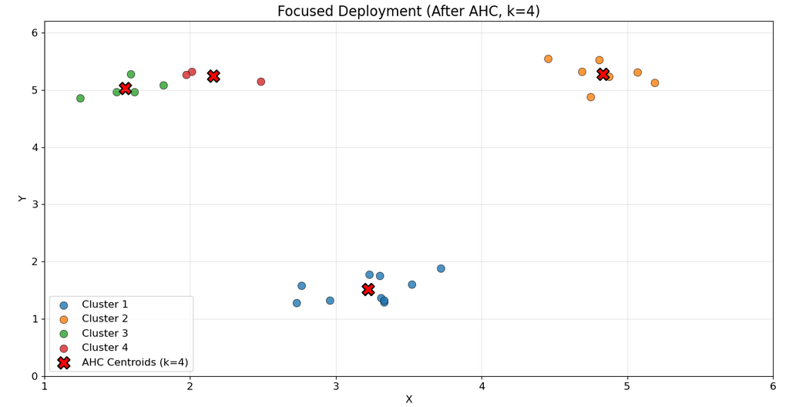
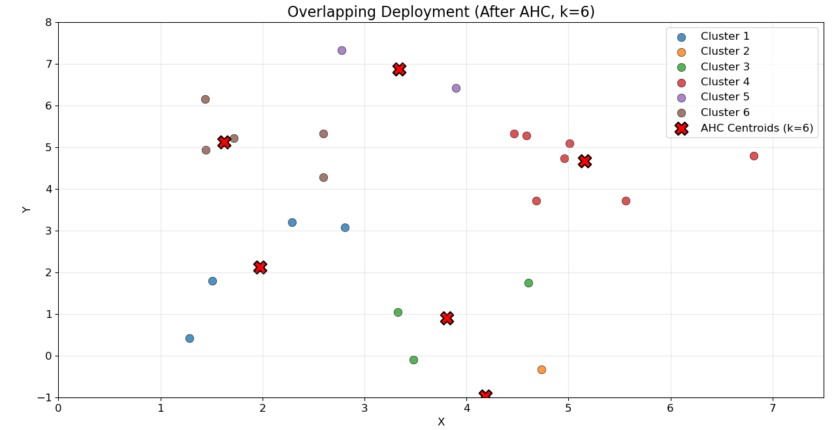
AHC - CLUSTERING
AHC Applied with Optimal k: Clustering was performed using the determined optimal number of clusters (k=4 for Focused, k=6 for Overlapping), assigning each point to a cluster and identifying centroids.
Clustering Outcomes Reflect Initial Data: Focused deployment resulted in relatively well-separated clusters closely matching initial visual groups, while Overlapping deployment yielded more intermingled clusters, reflecting its less distinct initial data distribution.

Slide 21
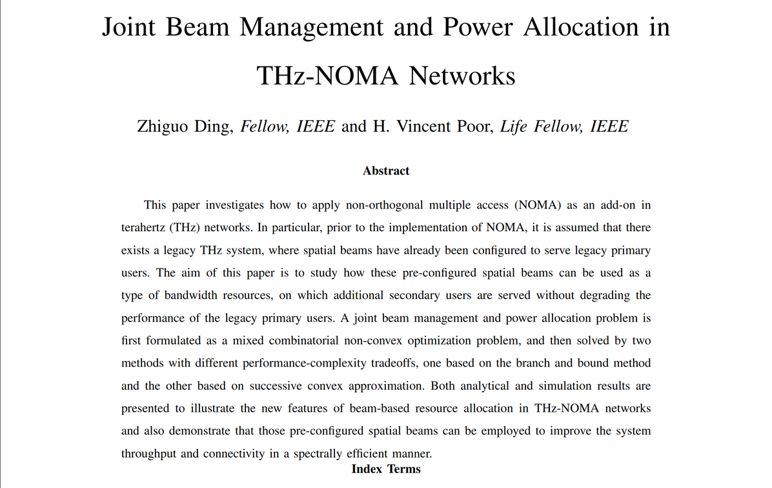
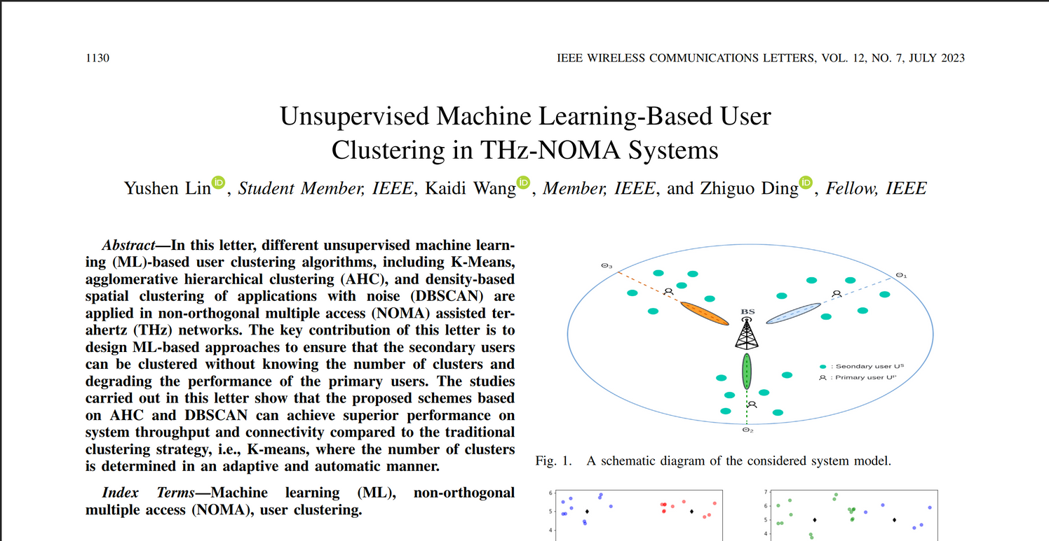

FUTURE GOALS
Unsupervised Machine Learning-Based User
Clustering in THz-NOMA Systems
Joint Beam Management and Power Allocation in
THz-NOMA Networks

Slide 22
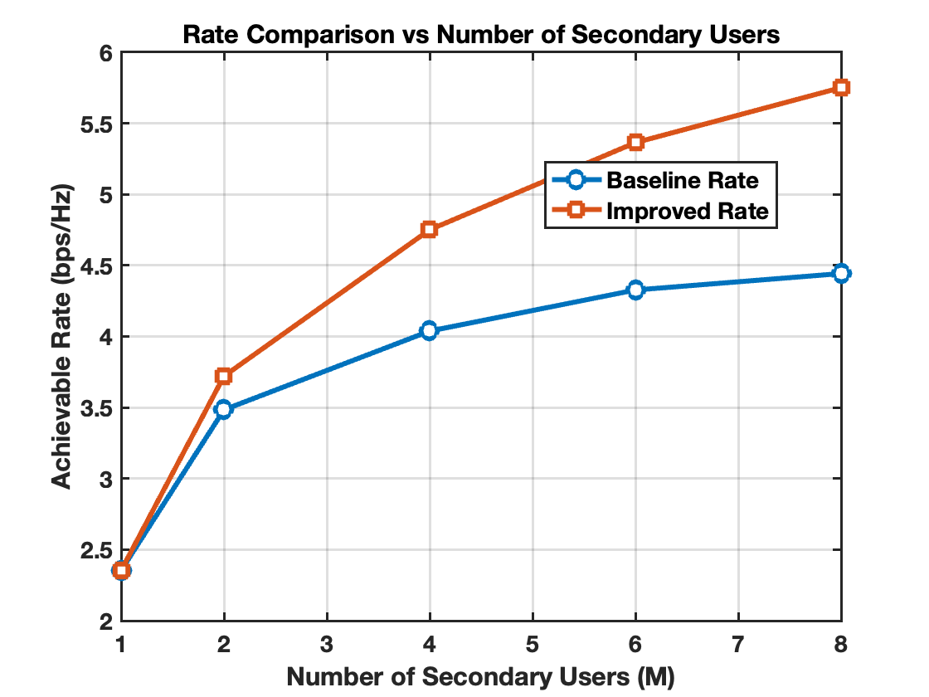
FUTURE GOALS
The Baseline Rate represents the performance when the transmitter simply selects the user with the highest channel gain and transmits all its power to that user. In simple terms
Algorithms Proposed
Successive Convex Approximation
Branch and Bound

Slide 23
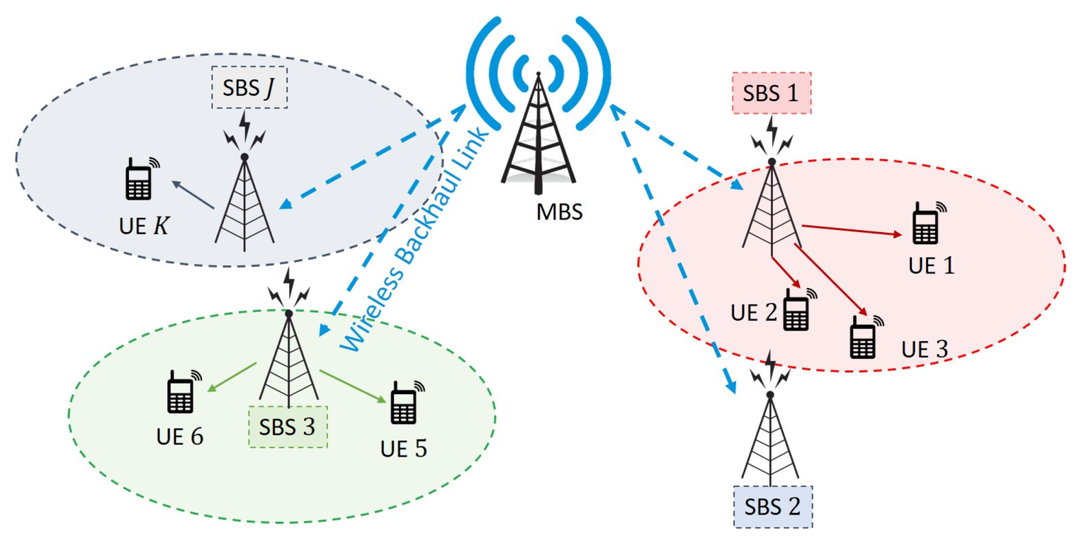

FUTURE GOALS
Proposed Algorithm
Input: User locations, CSI, preconfigured beams
Step 1: Cluster secondary users (unsupervised ML)
Step 2: Map clusters to beams
Step 3: Formulate joint beam-power allocation problem
Step 4: Solve via BB (small) or SCA (large)
Step 5: Deploy secondary users via optimized settings
Output: Beam-user mappings + power allocation

Slide 24

THANK YOU

Slide 25

QUESTIONS

